Slide 1



System Monitoring
with Graphite and Grafana
By Kant S.

Slide 2
Outline
Why Grafana ?
Introduction to Monitoring
What is Graphite & Grafana
Notes:
Monitoring system translates those metrics into a measurable user experience.
That measurable user experience provides feedback to the business to help ensure it’s delivering what customers want.
The user experience also provides feedback to IT to indicate what isn’t working and what’s delivering in sufficient quality of service.

Slide 3
Why Grafana
B
D
Tool B
Tool D
A
C
Tool A
Tool C

Slide 4



Why Grafana
A
B
C
D

Slide 5
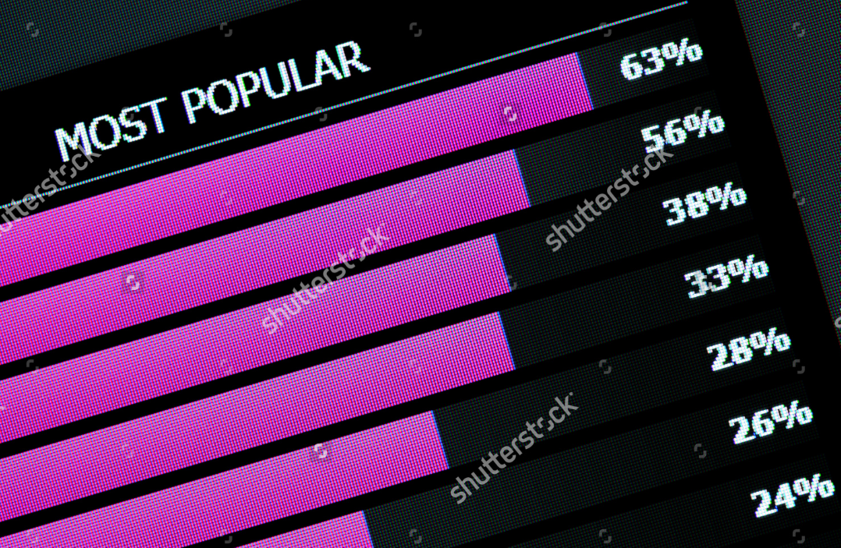
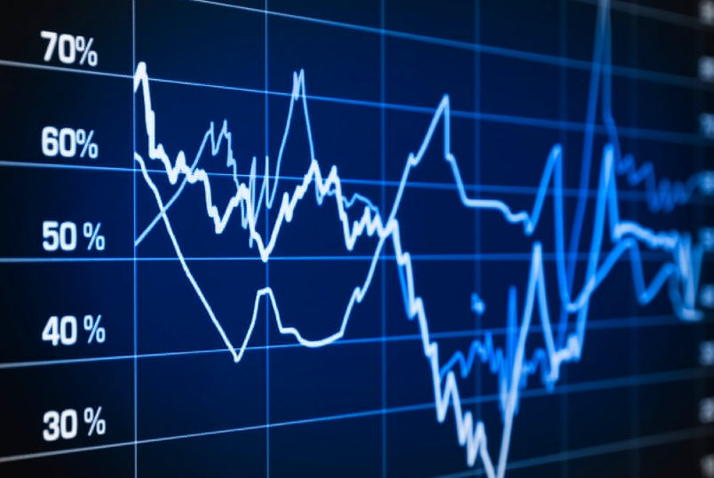
What is Monitoring
Monitoring is the tools and processes by which you measure and manage your systems
• The business value
• Information Technology process
Notes:
Monitoring system translates those metrics into a measurable user experience.
That measurable user experience provides feedback to the business to help ensure it’s delivering what customers want.
The user experience also provides feedback to IT to indicate what isn’t working and what’s delivering in sufficient quality of service.

Slide 6
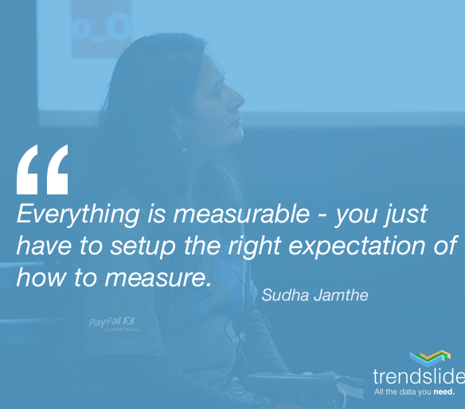
Notes:
JAMES TURNBULL cto of Kickstarter make a survey on programmer Community about monitoring,
And get around 1000 response back.

Slide 7


Why do we need Monitoring ?
1. Availability
2. Fault Detection
3. Capacity Planning
4. Alerting
Notes:
Availability : To ensure that our Systems and Services can serve customer.
Fault Detection : To identify when a resource becomes unavailable, starts to perform poorly, or identify what wrong in our systems.
Capacity Planning : When you Monitor your Systems, you can find the bottleneck, what should you do to improve or improving plan.
Alerting : After you create a good monitoring, you can have the automatic process, to check and alert when something go wrong.

Slide 8
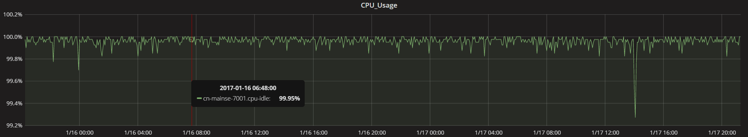
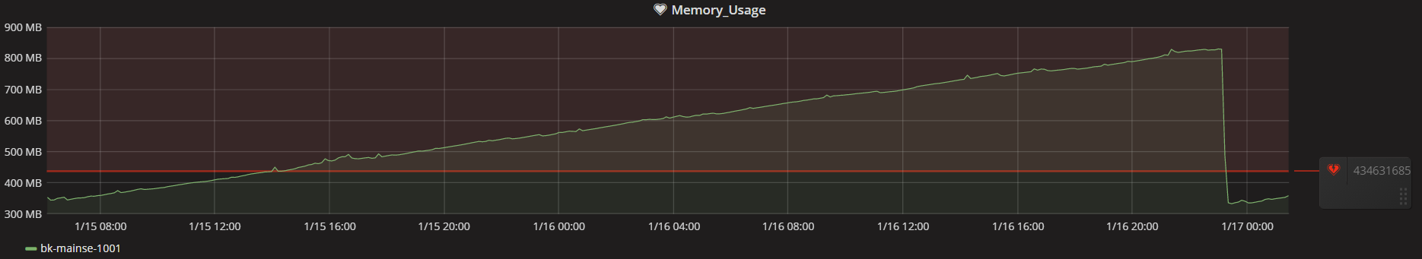
Preactive & Baseline
Preactive – What we should do before start monitoring,
1. Collected the data to build data historical and statistics
2. Understanding nature of data
Baseline – A point or line that we used for comparisons

Slide 9
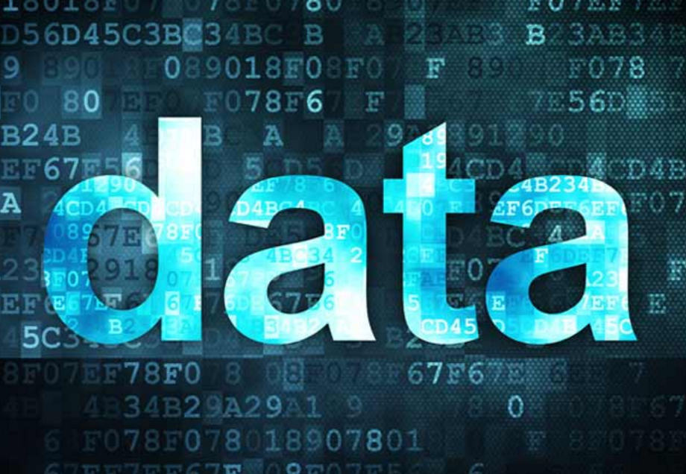
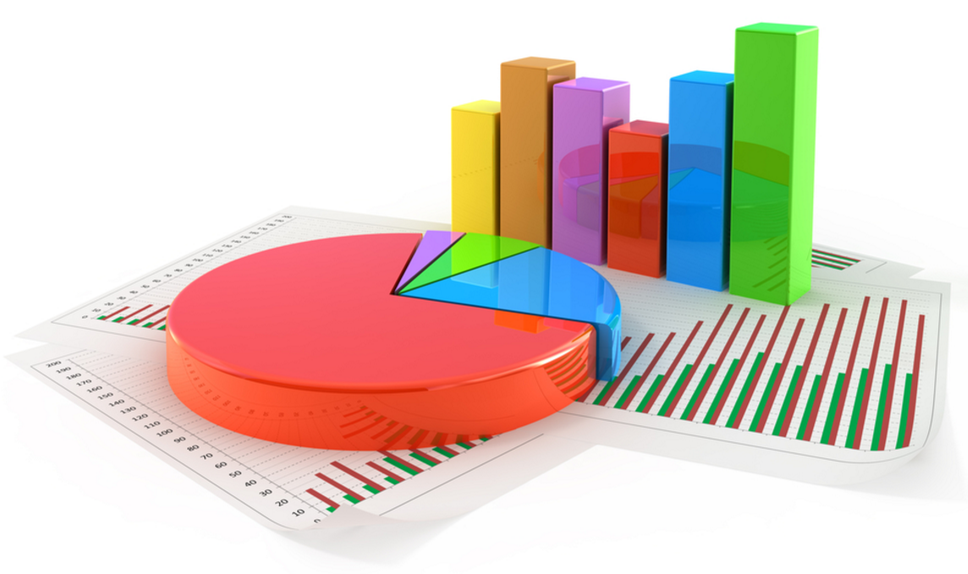
Monitoring Components
1. Data (Measurement)
2. Collector
3. Storage
4. Visualization tools
Notes:
Data – Understand what we monitor, Understand where it come from, Understand it nature.
Collector – How we get the data that we want
Storage – How and where we store those the data
Visualization – How we can represent the data

Slide 10
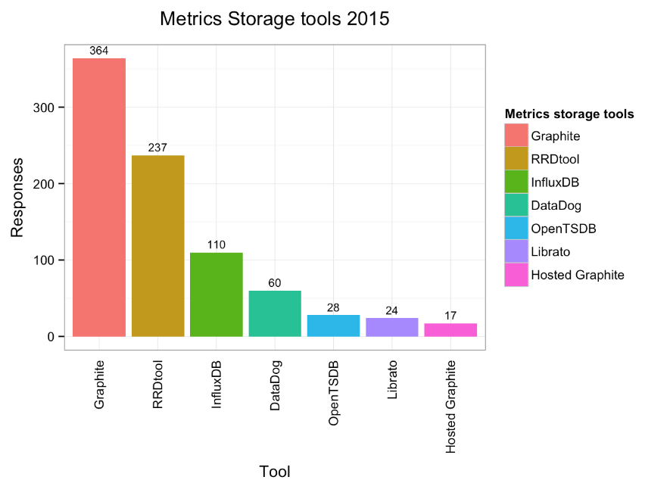


Storage

Slide 11
Graphite Concept
Graphite : Time Series Database (TSDB)
Graphite does two things
1. Store numeric time-series data
2. Render graphs of this data on demand
**** Graphite is not collector !!!
Storage : Metric_Name , Values , Times (Epoch)
Example : echo “test.metric 41 `date +%s`" | nc graphite-server.example.com 2003
Pros :
1. Web-based
2. Rapid Prototyping
3. Many Statistical Library
4. Chained Functions
5. Easy to understand metrics
Cons :
1. Not support on windows
2. Cannot store string
3. Not good for Dynamic metric
Notes:
What is Time Series Database ?
: TSDBs are databases that are optimized for time series data. Software with complex logic or business rules and high transaction volume for time series data may not be practical with traditional relational database management systems. Flat file databases are not a viable option either, if the data and transaction volume reaches a maximum threshold determined by the capacity of individual servers (processing power and storage capacity). Queries for historical data, replete with time ranges and roll ups and arbitrary time zone conversions are difficult in a relational database. Compositions of those rules are even more difficult. This is a problem compounded by the free nature of relational systems themselves. Many relational systems are often not modelled correctly with respect to time series data. TSDBs on the other hand impose a model and this allows them to provide more features for doing so.

Slide 12
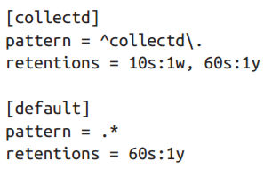
Graphite Components
1.Carbon
high-performance service that listens for time-series data
- Carbon-Cache – Listener to the Data
- Carbon-Relay – Relay the Data to another Carbon
- Carbon Aggregator – Aggregate Data
2.Whisper
Fixed-size database files, support data points down to a second.
Can keep Double-precision floating format
3.Graphite-Web
Graphite's user interface & API for rendering graphs and dashboards
Notes:
We can calculate whisper size, start from Retention that we specific
Ex. 1m:1d -> every 1 minute 1 data point and keep it 1 day
1 day have 60 * 24 = 1440 minutes = 1440 points
1 point use 12 bytes space = 17280 Bytes and another 12 Bytes for header
So it will be 17292 Bytes ~ 1.8 KB

Slide 13
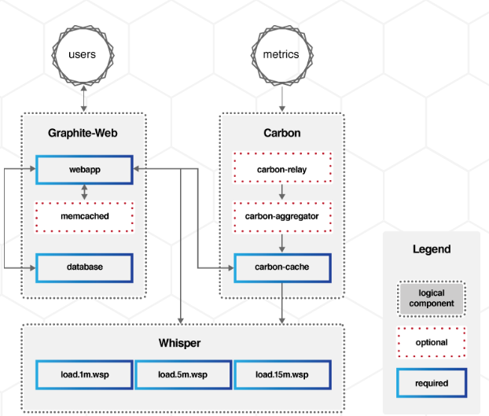
Notes:
From this diagram there are two flow :
1. Metric that contain Metric_name, value and epoch time had been sent by collector to Carbon, then carbon send data to store in whisper file
2. User using Graphite Web to see data that store in whisper file

Slide 14

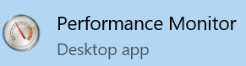

Collector
Server Performance
Other Measurement

Slide 15
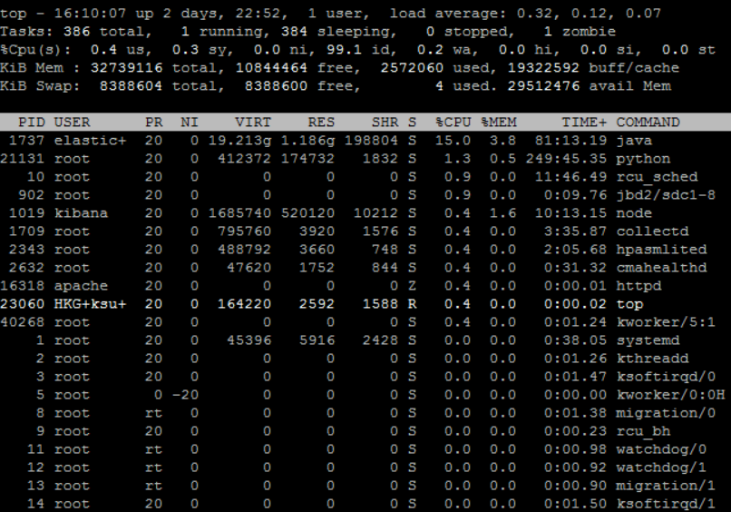
Collectd
Collectd : small daemon which collects system information periodically and provides mechanisms to store and monitor the values in a variety of ways.

Slide 16
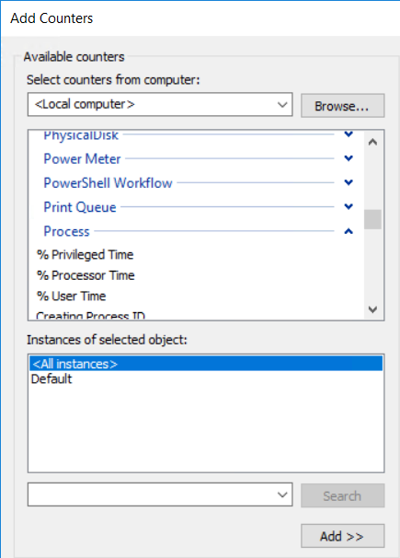
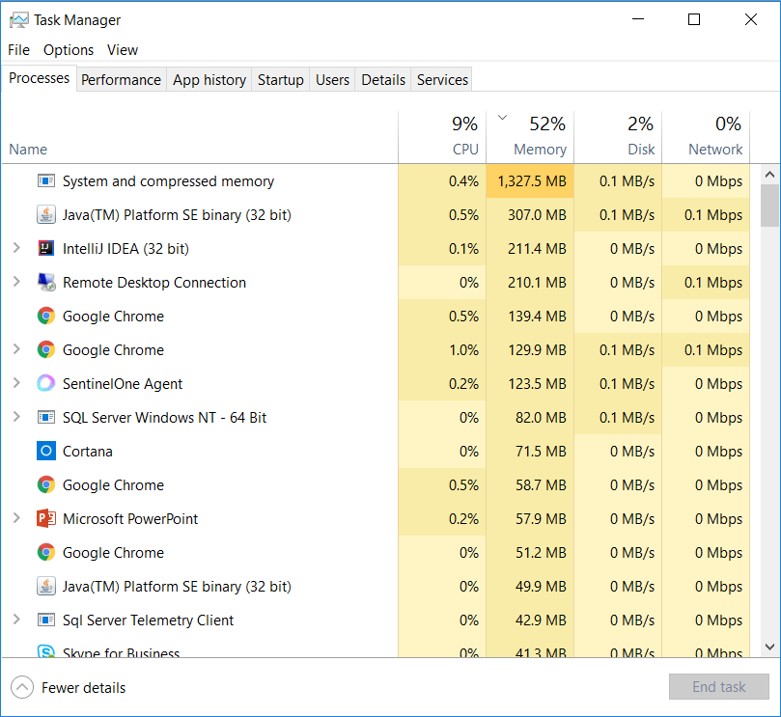
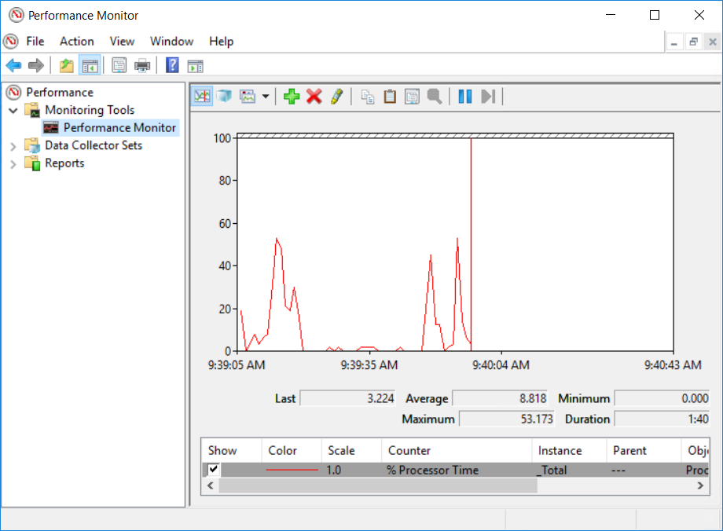
Window PerfMon

Slide 17
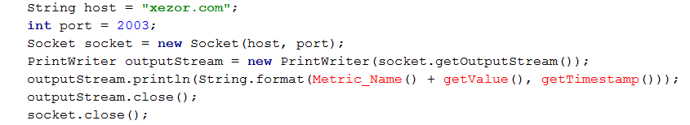
Code Example for collector
PORT=2003
SERVER=xezor.com
number = 1000
echo “testGraphite.TestA.TestB $number `date +%s`"|nc ${SERVER} ${PORT} --send-only
Notes:
Method for send : It same as sending message via TCP, just sending string that contain 3 things, Metric_Name, Value and Epoch time.
String host = "xezor.com"; int port = 2003;
Socket socket = new Socket(host, port); PrintWriter outputStream = new PrintWriter(socket.getOutputStream()); outputStream.println(String.format(Metric_Name() + getValue(), getTimestamp())); outputStream.close(); socket.close();

Slide 18
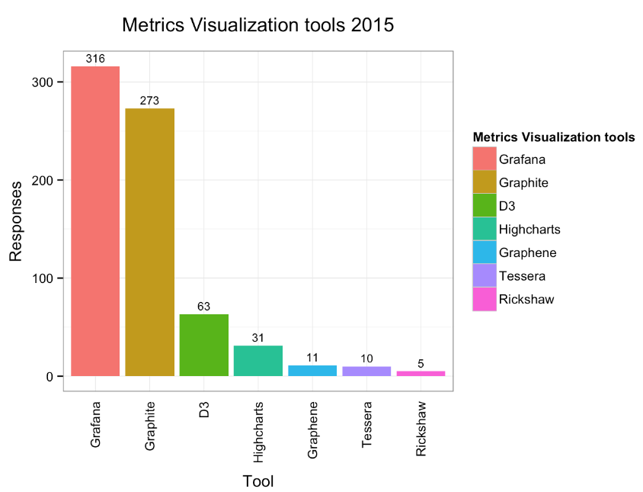
Visualization tools

Slide 19
What is Grafana
Graphite can represent data by it self.
However it not quite beautiful and easy to create dashboard
So, that why Grafana had been developed.
Now it can use with many storage : Graphite, InfluxDB, OpenTSDB, Prometheus, Elasticsearch, CloudWatch, KairosDB
Pros :
1. OpenSource
2. Web-based
3. Support windows installation
4. Many Data Source
5. Easy to use and beautiful
6. Access control in many layer

Slide 20
Thanks you
Q & A

